Slide 1
NEW PRODUCT
Neodymium Hydroxide
Coax Spray
Notes:
The need for radials, particularly on the lower HF bands, is a bane to many hams when using a quarter wavelength vertical antenna. Is it possible to find a more convenient alternate but with good efficiency?

Slide 2
Europaeische Electromagnetishe
Regierung (EER)
Irrenhausen, Germany
Notes:
At the Europaeische Electromagnetishhe Regierung (EER) in Irrenhausen Germany, a researcher in magnetic domains has developed a revolutionary new product that holds out major promise to radio communications worldwide

Slide 3
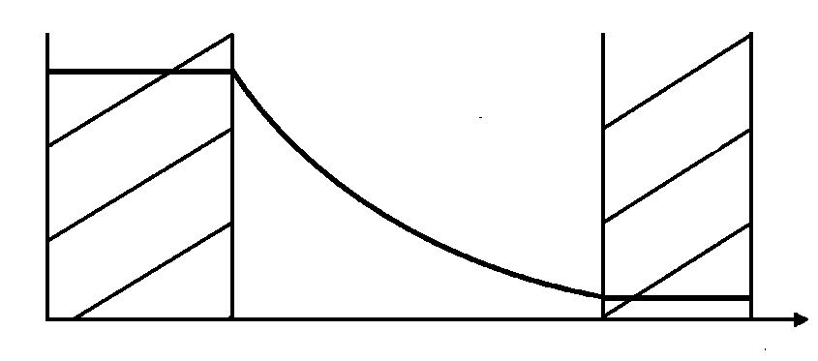
Reduction of SWR
Longitudinal Mono-directional
Neodymium Hydroxide Nd3O4
Notes:
Axial Neodymium Hydroxide spray or Nehox Orange, as it is to be marketed, when applied mono-directionally longitudinally to coaxial cable greatly reduce SWR, traditionally a burden to the RF industry. This curve show the reduction of the reflected wave when it encounters a Neodymium Hydroxide coating on the outside of the coax shield.

Slide 4
Chemist
Gerhart
Friedrich
Home
Notes:
The SWR-reducing effect was first observed by chemist George Home in 1987 while working as a technical consultant for Apex Corporation in Deadwood City, North Dakota on the coatings used for magnetic recording media. He noted that if rare earth particles were combined with conventional magnetic iron oxide tape particles, and applied longitudinally in one direction to coaxial cable, that the distributed incident S11 reflection of the standing wave (SWR) was reduced. Though in his paper in the prestigious British Science journal Nurture, he noted that the observed effect was very small.

Slide 5
Physicist
Wilhelm
Klang
Notes:
Late last year, however, Home’s preliminary discovery became a practical reality when Physicist Wilhelm Klink of the EER reacted finely divided powdered elemental metallic neodymium, widely used in the manufacture of powerful rare-earth magnets, with unstable Praseodymium tetra-hydroxide. The resulting RF-active compound Ne₃OH₄ generates a high intensity circularly polarized Pointing field that nearly totally eliminates SWR by re-orienting the magnetic domains of the S-31 reflection coefficient of the standing wave

Slide 6
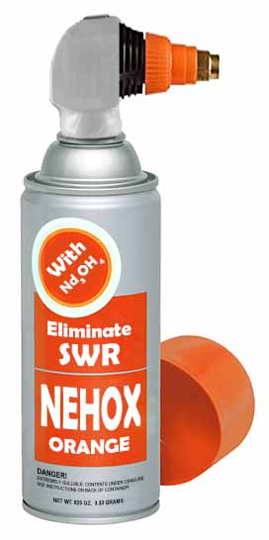
Aeorsol Dispenser with Axial Orientation Nozzle
Notes:
The product will be marketed in an aerosol spray with a specialized differential nozzle that mono-directionally axially orients the micro-magnetic particles. A fast-drying conformal polyacetal polymer propellant dries almost instantly, stabilizing the orthogon field which blocks the reflected wave.
Major chemical manufacturers worldwide are currently constructing production facilities.

Slide 7
Order Yours
TODAY
Helen Waite.com
or
Larson E Enterprises.com
Notes:
The product is now only in limited production by Cateleptic Adhesives GMBH, New Mexico, but will likely soon be marketed widely. Complementary trial-size samples are currently available to the general public
For a trial quantity go to Helen Waite or Larsen E. Enterprises Krankenhaus, Germany.

Slide 8
W6NBC

